Slide 1


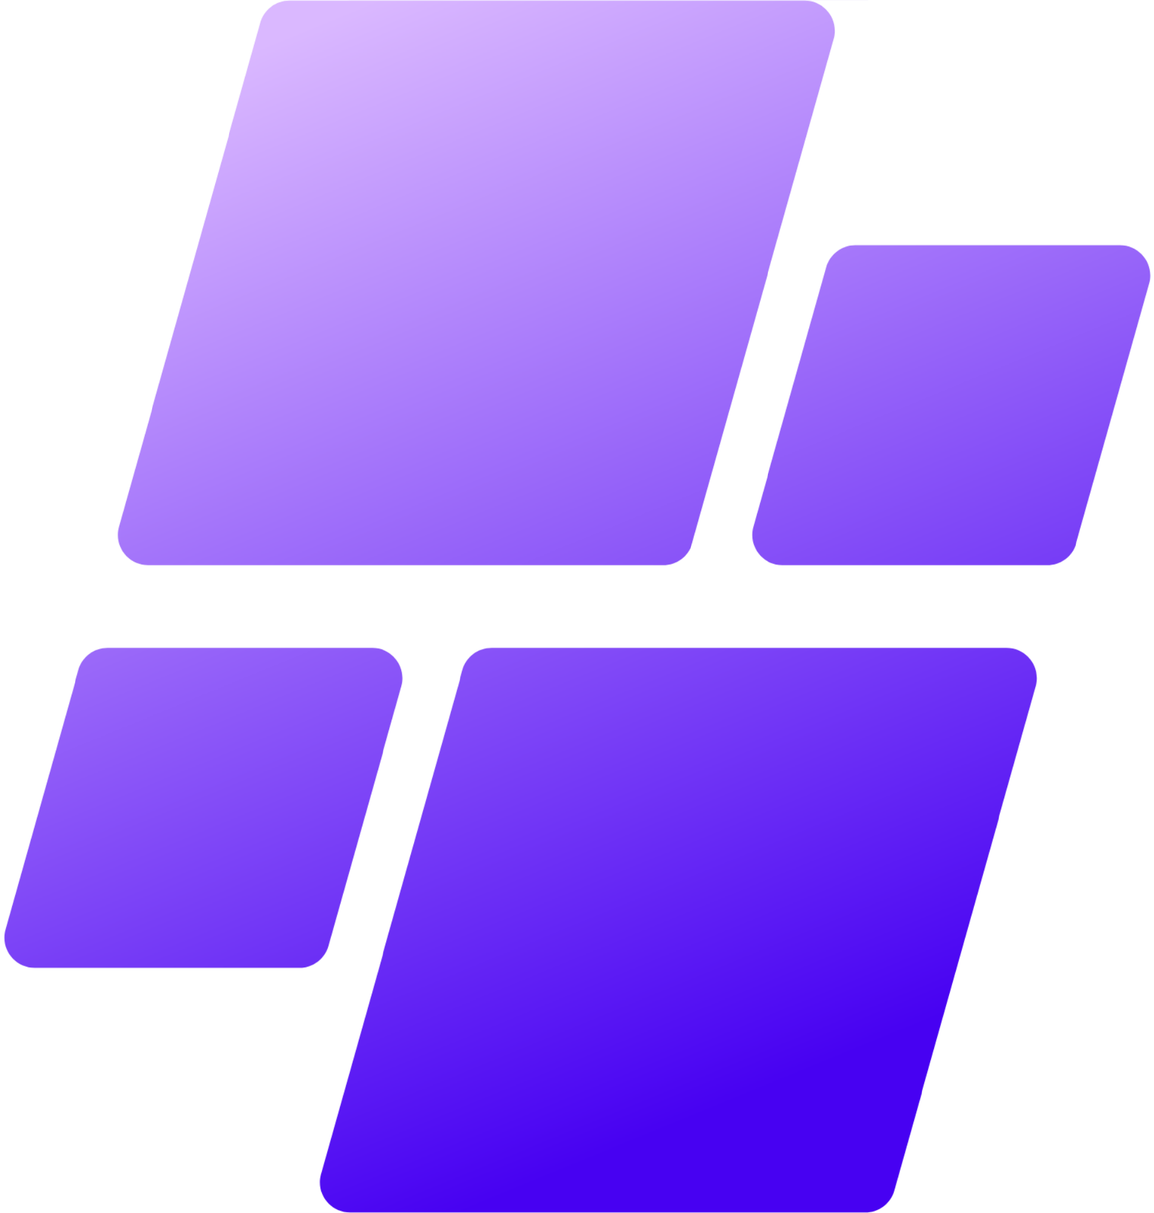
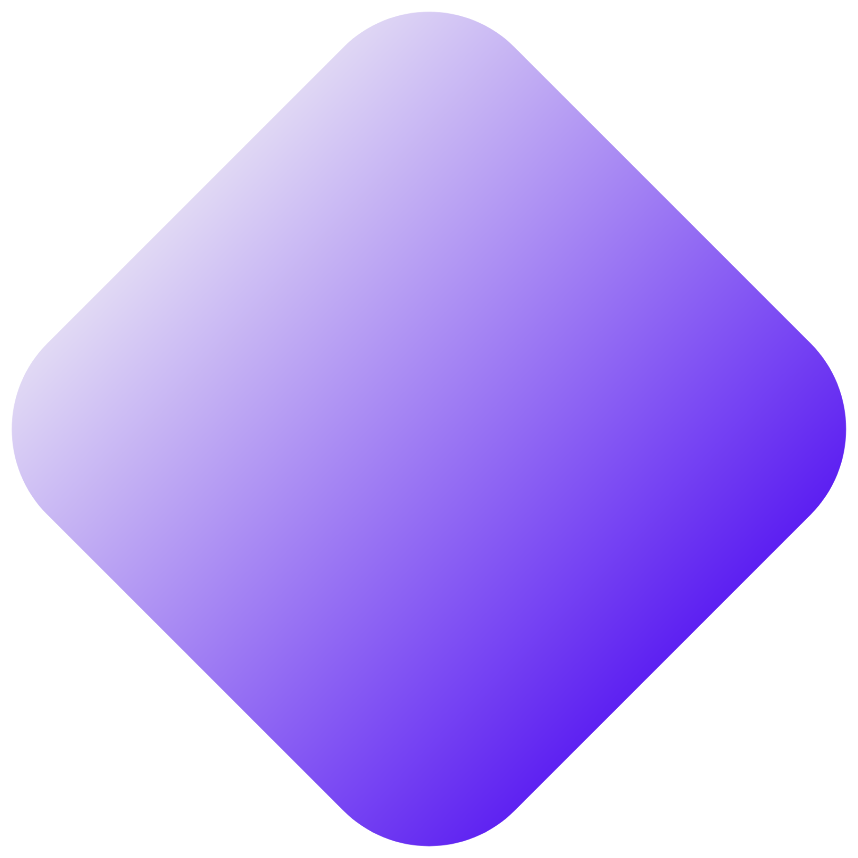

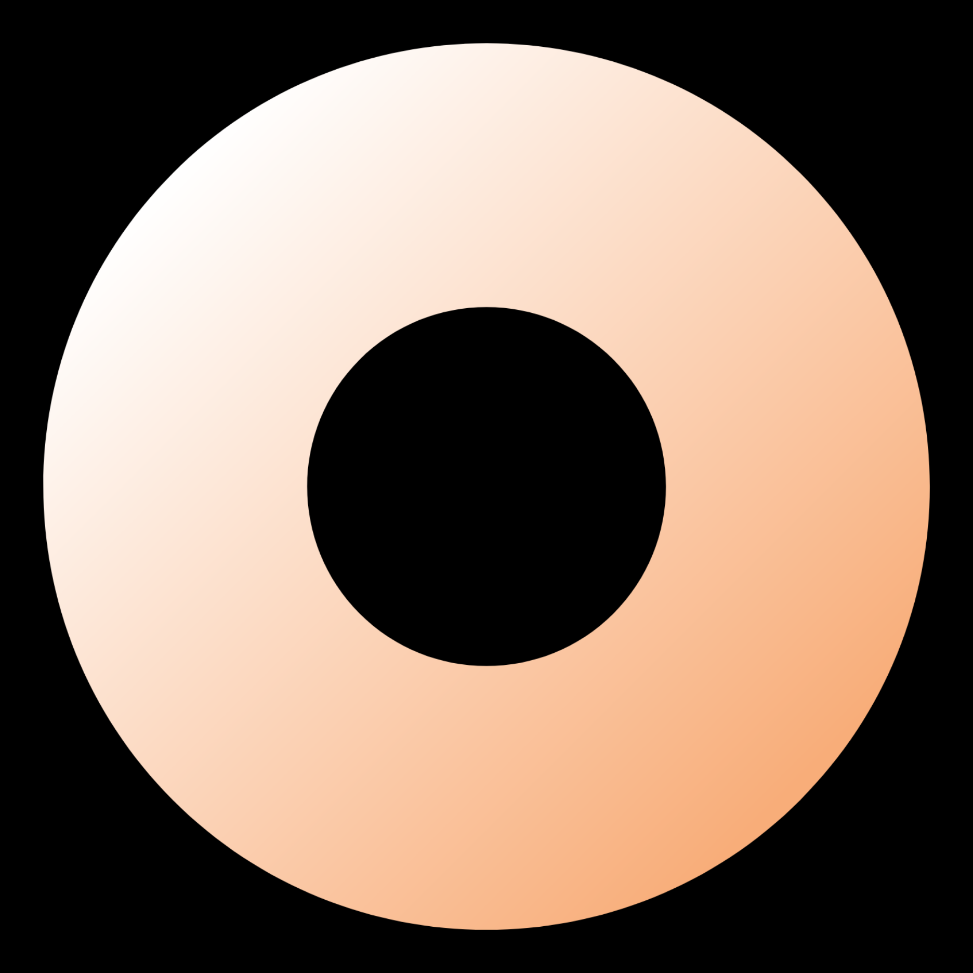


AITRONICS
24 JUNE 2023
PRESENTED BY
ANJALI SAH
MERN STACK
E-COMMERCE
WEBSITE

Slide 2
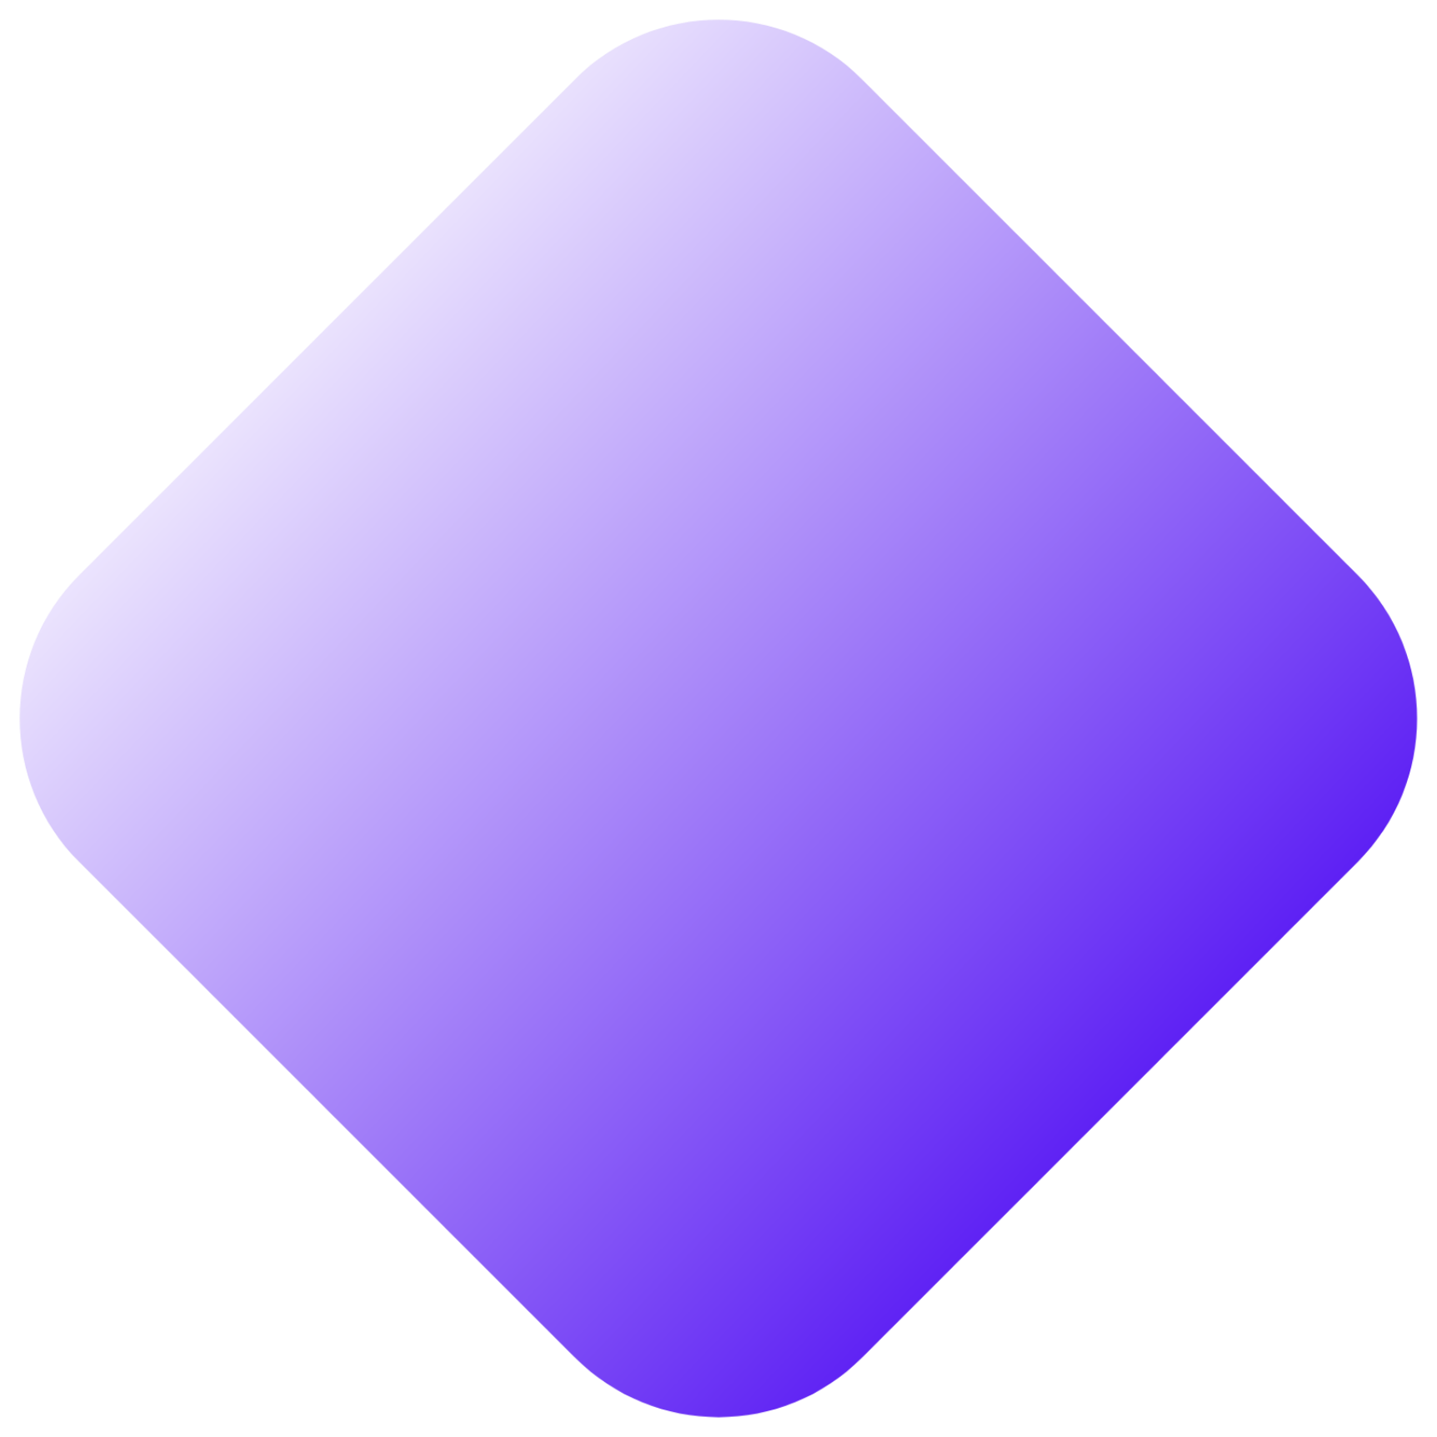
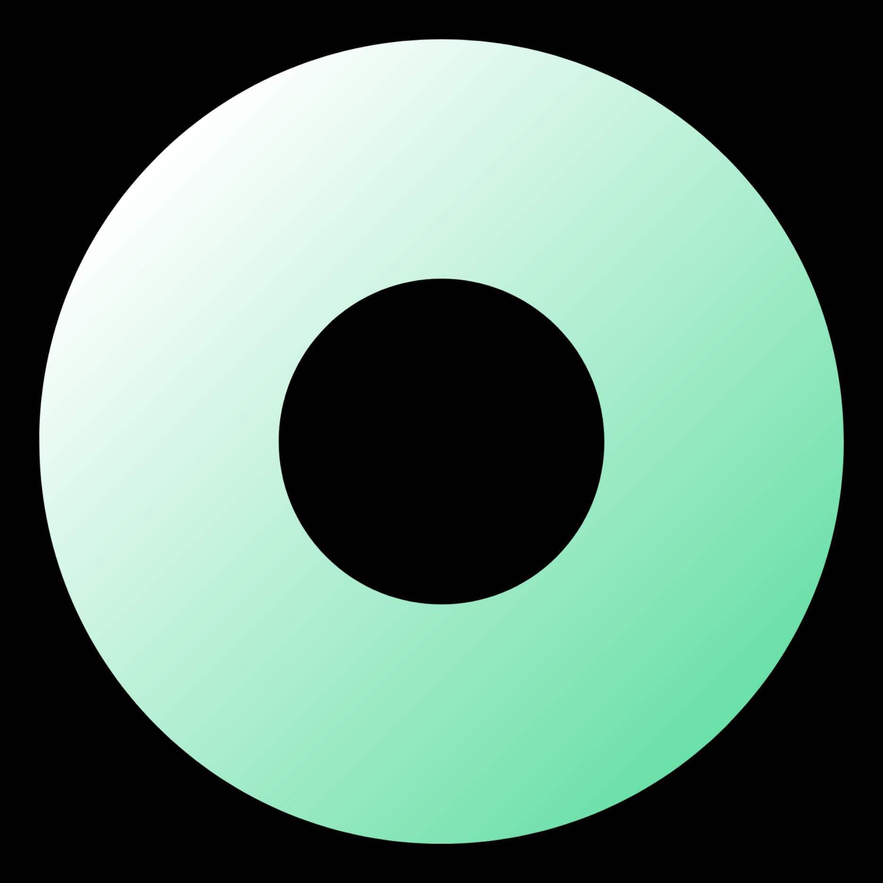


What is E-commerce?
E-commerce is the buying and selling of goods and services online. It has become important due to its numerous benefits. Firstly, it offers convenience and accessibility, allowing customers to shop anytime and from anywhere. Secondly, e-commerce expands the reach of businesses, enabling them to tap into global markets and increase their customer base. It also reduces costs by eliminating the need for physical stores and associated expenses.
Moreover, e-commerce provides a wide variety of products and allows customers to compare prices and make informed choices. It enhances efficiency through faster transactions and personalized experiences. Lastly, e-commerce generates valuable data insights that businesses can utilize for marketing strategies and decision-making, leading to improved performance. Overall, e-commerce has revolutionized the way we shop and conduct business, making it an essential part of the modern economy.

Slide 3


INTRODUCTION
What is MERN Stack?
A stack is the mixture of technologies used to create Web applications. Any web application will be made utilizing various technologies like (frameworks, libraries, databases). The MERN stack is a JavaScript stack that is intended to make Application Development process smoother.
A “stack” refers to any combination of coding languages, tools, and frameworks developers use to create software products for their clients. A stack contains different layers of components that play a vital role in the process of software product creation.
Client-side - front-end (HTML, CSS, JavaScript)
Server-side - back-end (OS, web server, programming language, web framework, databases)

Slide 4
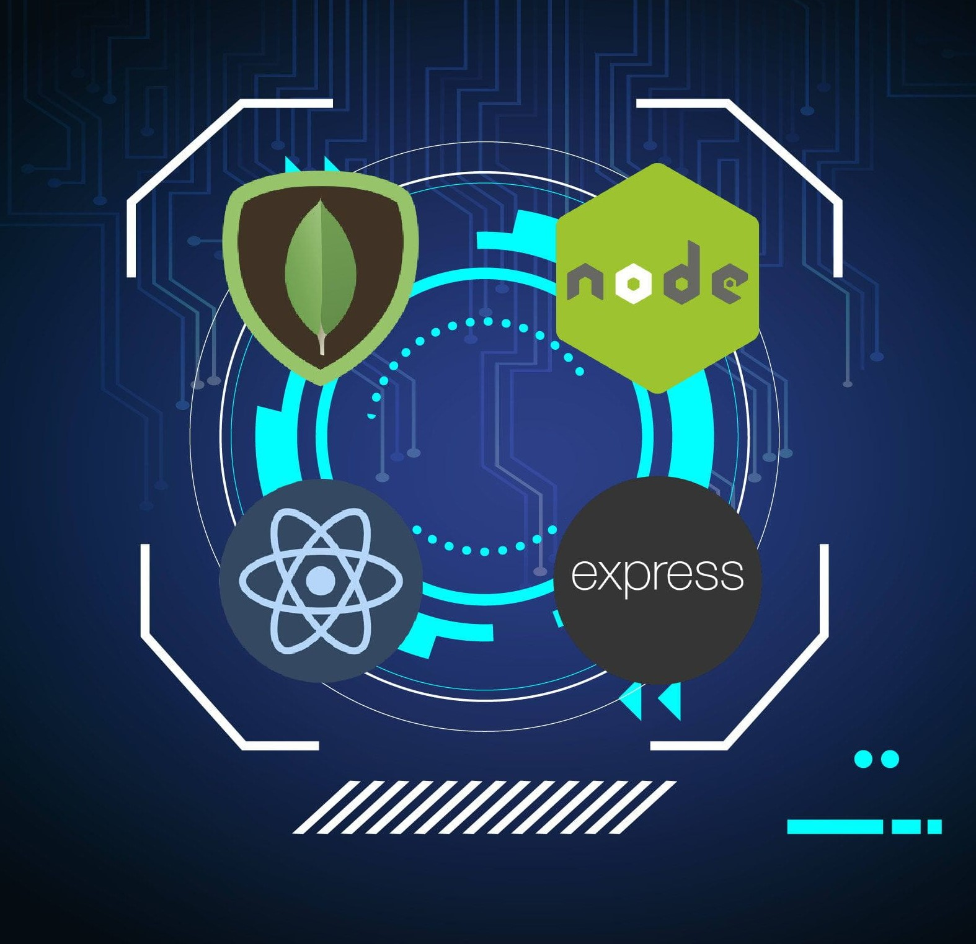
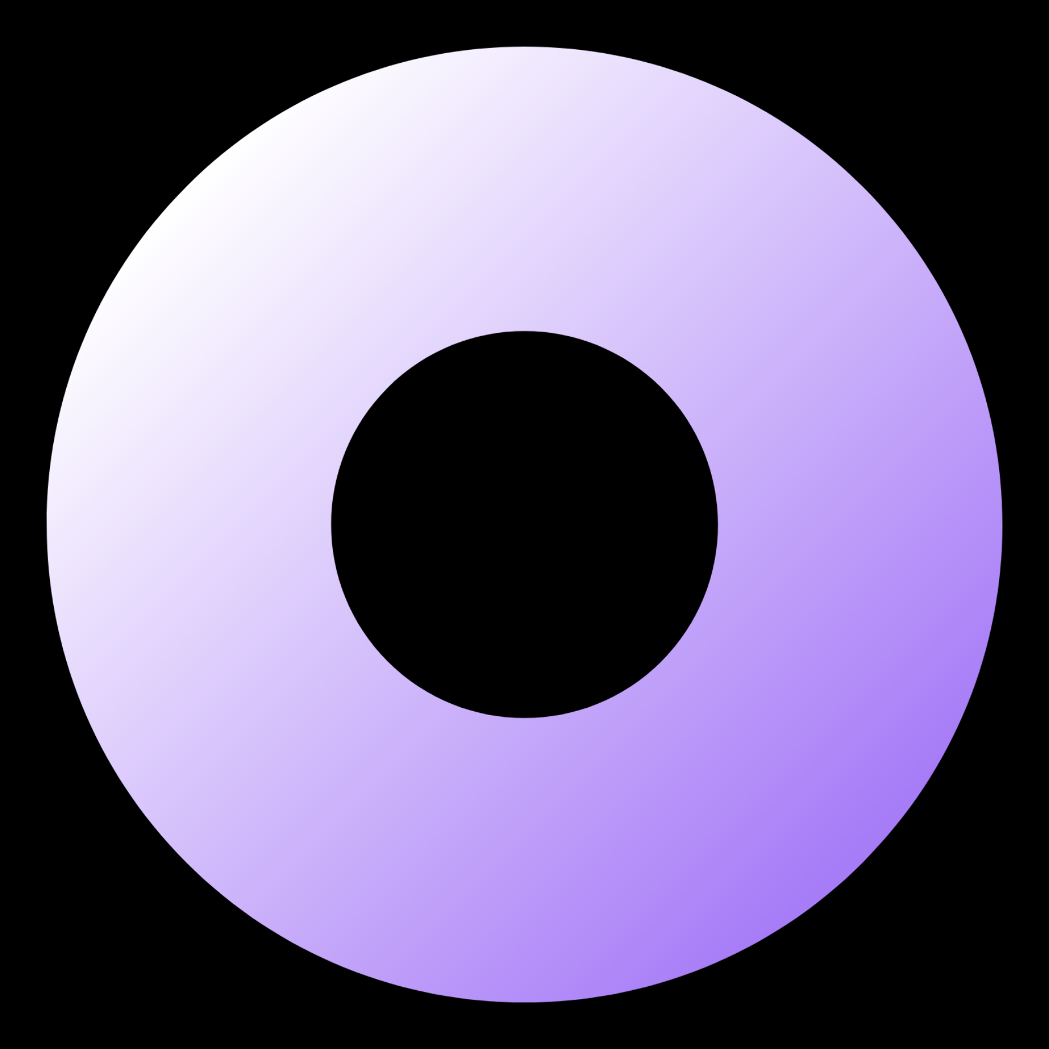
Why MERN Stack?
Advantages of MERN Stack, Many factors come into play here, like:
Type and size of the project
Team expertise and knowledge bases
Cost of the overall development
Full stack development capabilities.
Code reusability and SEO Friendly.
Real-time updates and dynamic user experience.
Rich ecosystem of tools and libraries.
Scalability for high traffic.
Cross Platform compatibility.
Maintainability and Consistency with JavaScript throughout the development process.

Slide 5


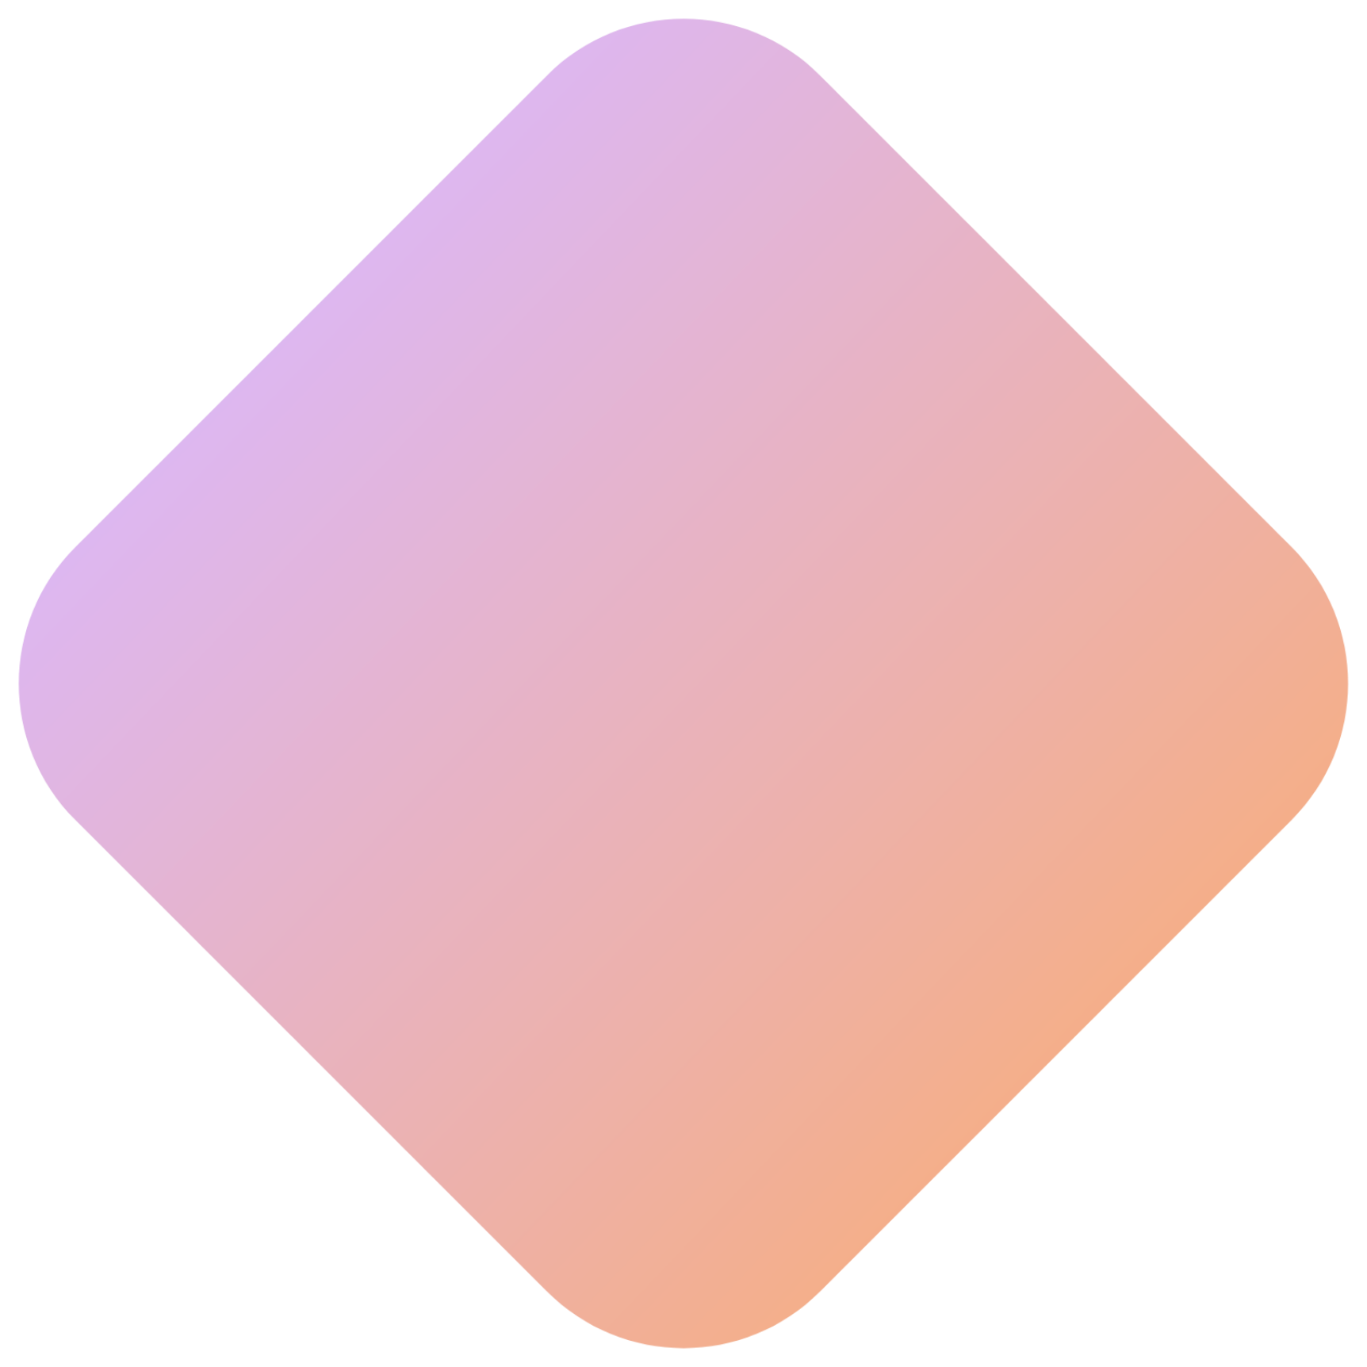
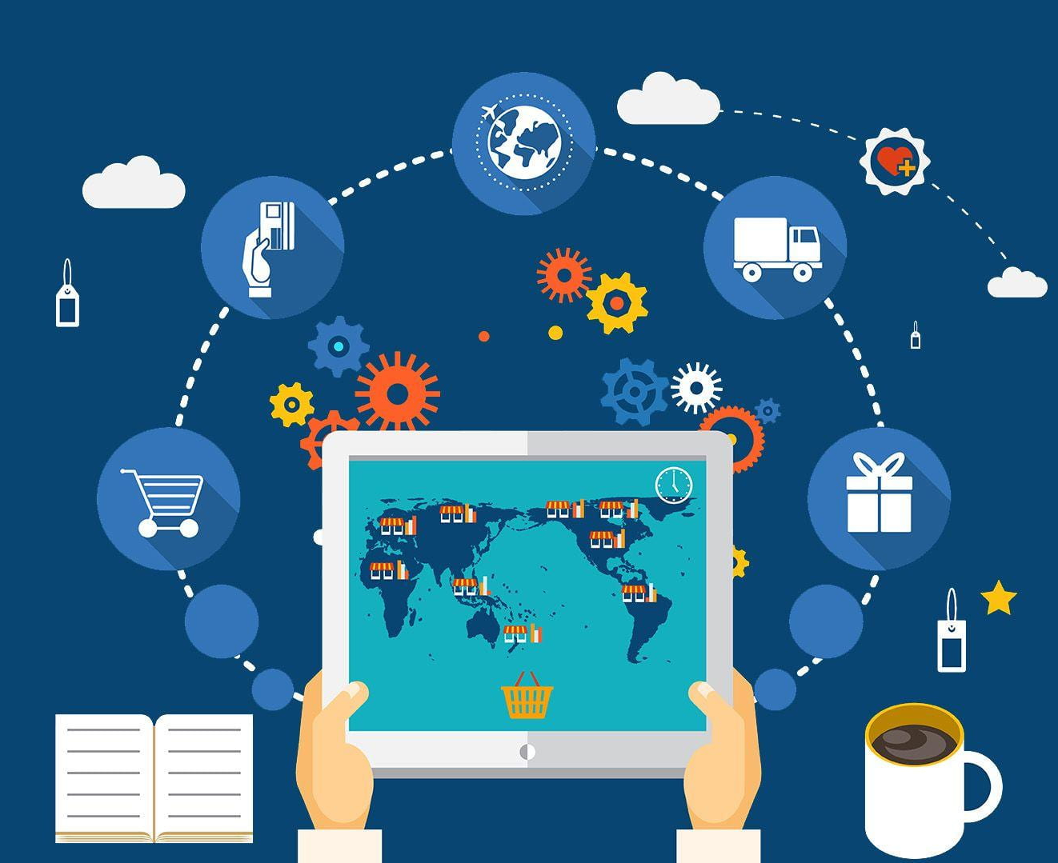
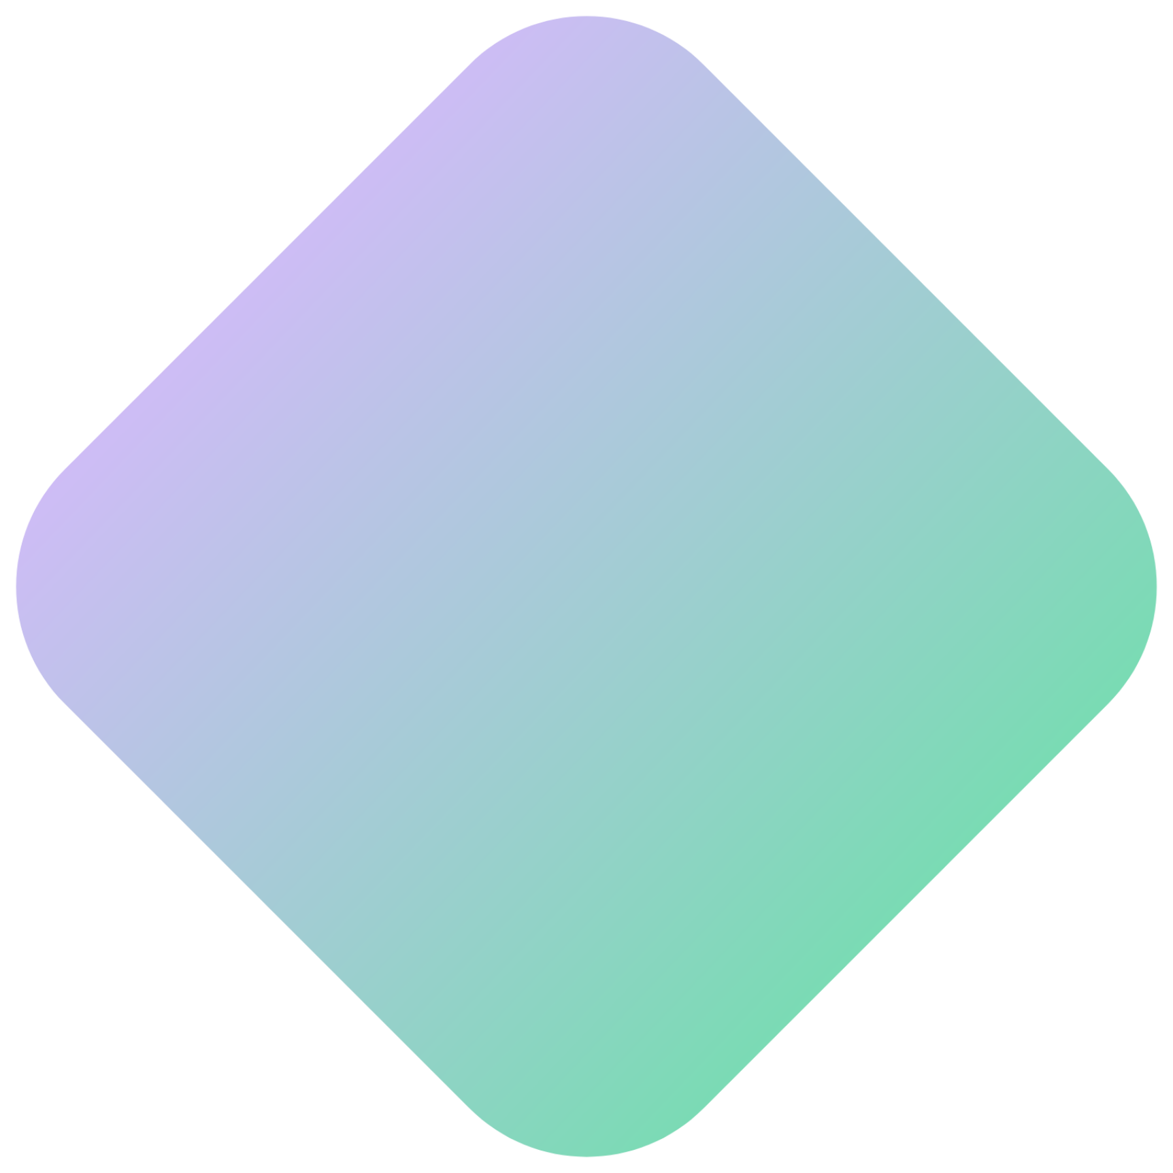
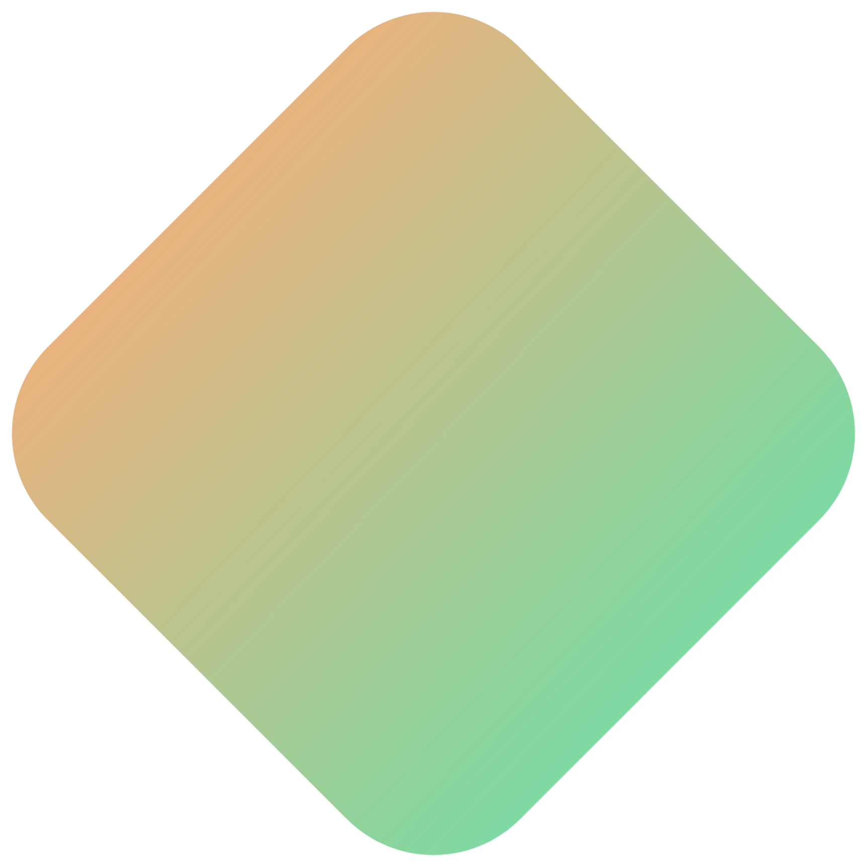
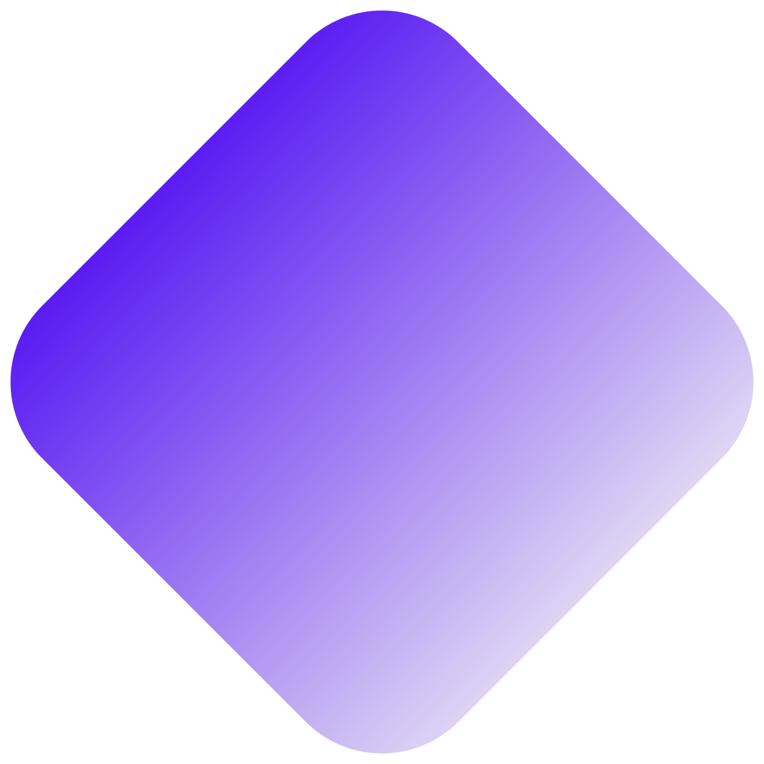
What is MERN Stack Development?
MERN is an acronym used to describe a specific set of JavaScript based technologies that are used in the web application development process. It is designed with an idea to make the development process as smooth as possible.
Mongo DB
Express JS
React JS / Redux
Node JS

Slide 6

1. MONGO DB
Mongo DB is a free open-source, cross-platform document-oriented database program. It is classified as a No SQL database program, which means that data is stored in flexible documents with JSON-based query language. This also means that the size of the content number of fields in the documents tends to vary. The whole data is structured in a way to be prone to change over time.
MongoDB is known as a flexible solution that is always easy to scale.

Slide 7

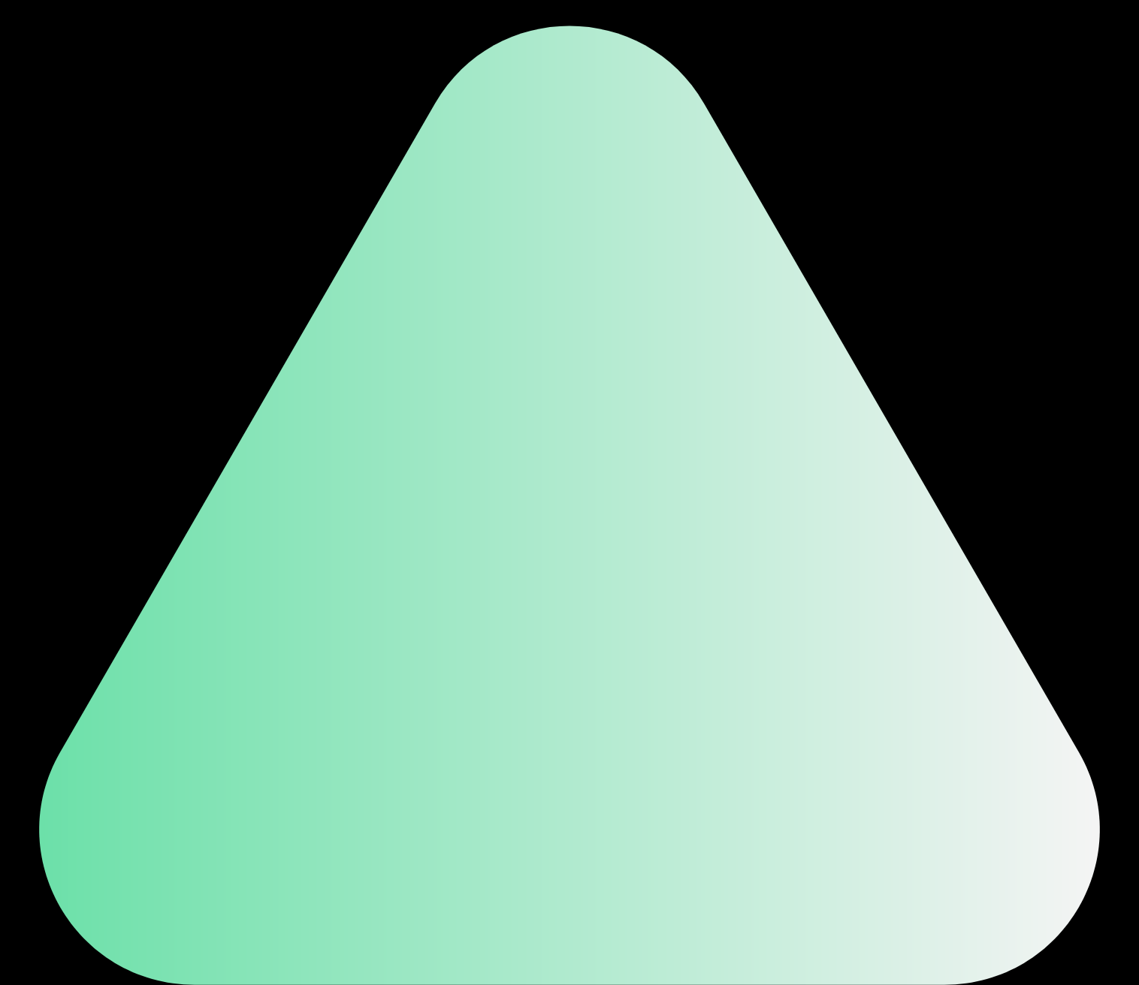

2. EXPRESS JS
Express is open-source software, it can be classified as a web application framework for Node.js. To be more precise, Express JS is made for developing web apps and APIs.
Instead of manually writing full web server code in Node.js, developers use this MERN component to simplify the coding process. Express is a fast, assertive, essential and asynchronous in nature. You can assume express as a layer built on the top of the Node.js that helps manage a server and routes. It provides a robust set of features to develop web and mobile applications.

Slide 8

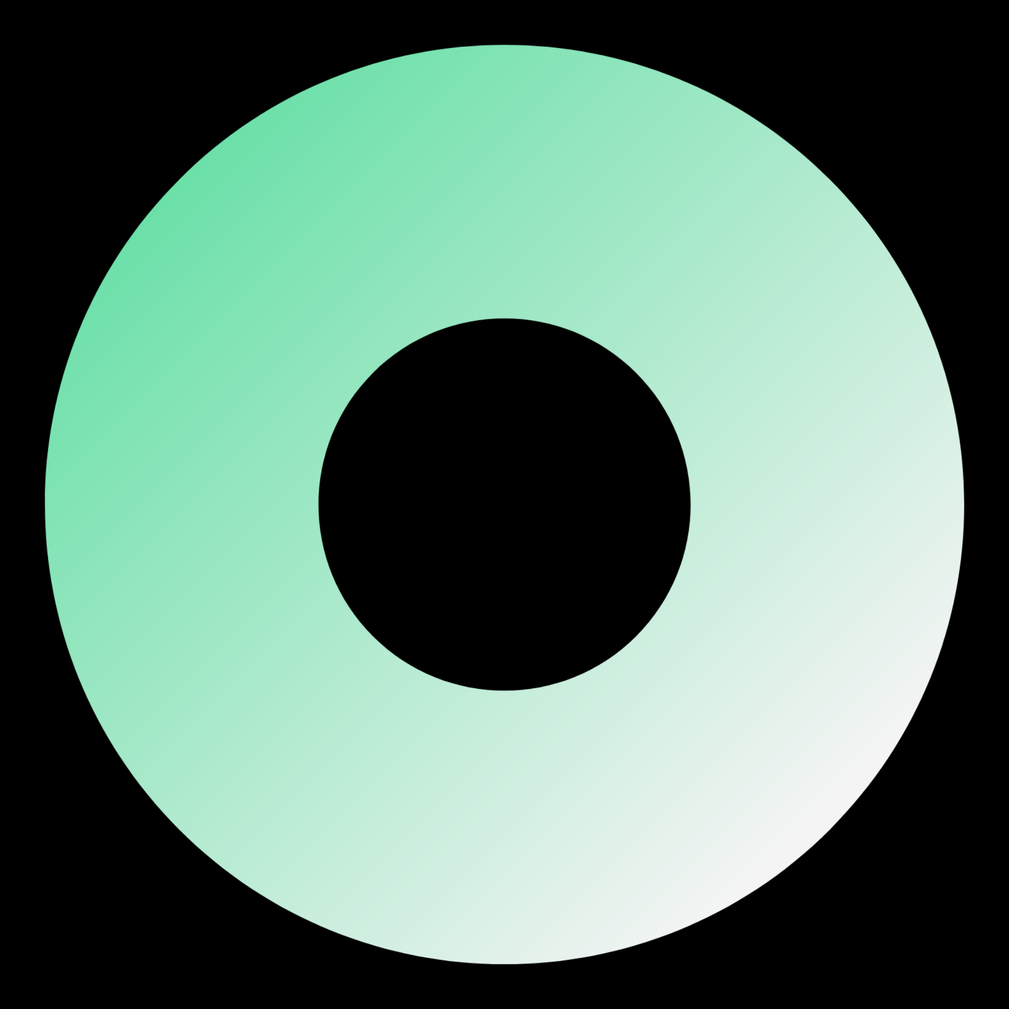
3. REACT JS
React is a JavaScript library used for building user interfaces. Originally created by a software engineer who worked for Facebook, React was later on open-sourced.
This specific library is often used for creating views rendered in HTML. The views that you create in Reach declarative, which means that you don’t have to deploy additional time on managing the changes and effects they have on the data.
React uses a full-featured programming language (JavaScript) to construct repetitive or conditional DOM elements.
With React, the same code can run on both the server and the browser.

Slide 9

4. NODE JS
Node.js is an open-source and cross-platform JavaScript runtime environment. Node.js runs the V8 JavaScript engine, the core of Google Chrome, outside of the browser. This allows Node.js to be very performant.
A Node.js app runs in a single process, without creating a new thread for every request. Node.js provides a set of asynchronous I/O primitives in its standard library that prevent JavaScript code from blocking and generally, libraries in Node.js are written using non-blocking paradigms, making blocking behavior the exception rather than the norm.
When Node.js performs an I/O operation, like reading from the network, accessing a database or the filesystem, instead of blocking the thread and wasting CPU cycles waiting, Node.js will resume the operations when the response comes back.

Slide 10
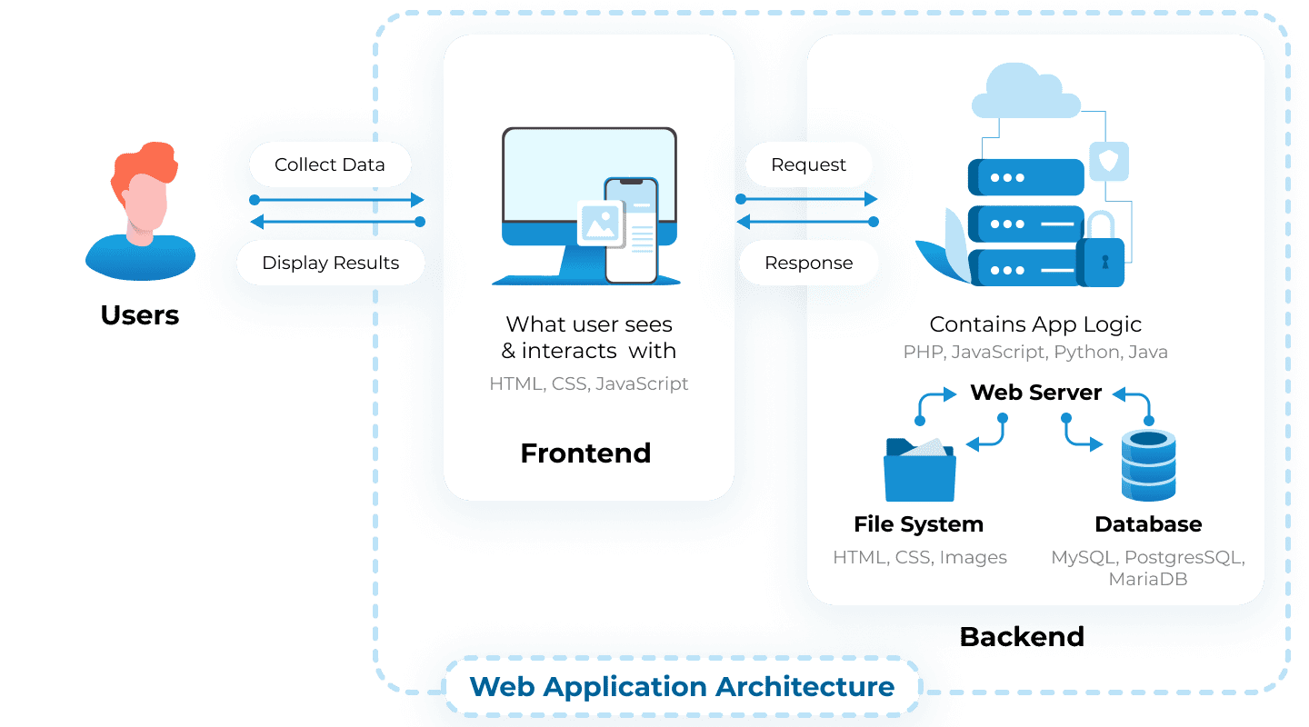
Architecture Diagram of the
MERN E-commerce Application
The data and requests between the components in the MERN e-commerce application:
1. User Client to Express.js API Server:
The User Client, built using React.js, sends HTTP requests to the Express.js API Server.
These requests can include actions such as retrieving product listings, adding items to the cart.
The requests are typically sent using RESTful APIs
2. Express.js API Server to MongoDB Database:
The Express.js API Server receives the requests from the User Client.
It processes and validates the requests, ensuring the proper authentication and authorization.
The server then interacts with the database to retrieve or modify data based on the request that involve querying the database for product information, updating details, or storing new orders.
3. MongoDB Database to Express.js API Server:
The MongoDB database responds to the Express.js API Server with the requested data or the outcome of the requested operation.
This response typically includes JSON-formatted data containing the requested information or a success/error status message.
4. Express.js API Server to User Client:
The Express.js API Server sends the response received from the MongoDB database back to the User Client. This response can include product listings, updated user information, or confirmation of a successful transaction.
The User Client receives the response and updates the user interface accordingly to provide the requested information.

Slide 11
Development Process
.
The development process of a MERN Stack e-commerce application typically involves the following steps:
1. Requirement Gathering: Understand the client's requirements, target audience, and desired features for the e-commerce application. Document the functional and non-functional requirements.
2. Design and Wireframing: Create a design plan and wireframes to visualize the user interface and application flow. Determine the structure, layout, and navigation of the application.
3. Technology Stack Selection: Choose the MERN Stack as the development framework. Set up the development environment with the necessary tools and libraries.
4. Database Design: Design the MongoDB database schema, including collections, documents, and relationships. Define the fields and data structure to store product information, user details, and other relevant data.
5. Backend Development: Develop the server-side using Node.js and Express.js. Implement the application's RESTful APIs endpoints for handling requests and responses. Write server-side logic, including authentication, authorization, and business logic.

Slide 12
Development Process
.
6. Frontend Development: Build the user interface using React.js. Create reusable components, implement routing for different pages, and integrate with the backend APIs for data retrieval and submission. Focus on responsive design and user experience.
7. Integration and Testing: Integrate the frontend and backend components. Conduct thorough testing to ensure functionality, usability, and performance. Perform unit testing, integration testing, and user acceptance testing.
8. Deployment and Hosting: Prepare the application for deployment to a production environment. Set up hosting infrastructure, configure the server, and deploy the application. Ensure proper security measures are in place, such as SSL certificates and protection against common vulnerabilities.
9. Continuous Improvement: Monitor the application's performance, gather user feedback, and make iterative improvements based on user needs and market trends. Continuously update and enhance the application with new features and optimizations.
10. Maintenance and Support: Provide ongoing maintenance and support for the application, including bug fixes, security updates, and feature enhancements. Monitor server performance, handle scalability, and address user concerns promptly.

Slide 13
Potential Challenges
Technology Compatibility:- Solution: Manage versions and conduct thorough testing to identify and resolve compatibility conflicts.
Scalability and Performance:- Solution: Implement caching, optimize database queries, and consider scaling options like load balancing and database shading.
Security Vulnerabilities:- Solution: Follow security best practices, implement input validation, proper authentication, encryption, and regular security audits.
Payment Gateway Integration:- Solution: Utilize well-documented payment gateway APIs, follow integration guidelines, and thoroughly test the payment flow.
Cross-Browser Compatibility:- Solution: Conduct cross-browser testing, use CSS frameworks for compatibility, and employ progressive enhancement techniques.
Performance Optimization:- Solution: Optimize rendering, use virtual DOM efficiently, lazy load components and images, and employ performance profiling tools.
User Experience and Usability:- Solution: Conduct user testing, gather feedback, iterate on design and functionality, and follow UX/UI best practices.
Third-Party API Integration:- Solution: Review API documentation thoroughly, handle errors gracefully, implement proper error handling, and closely monitor API changes.
Project Management and Collaboration:- Solution: Use project management tools, adopt agile methodologies, maintain clear communication channels, and conduct regular team meetings.

Slide 14
Common Issues and Limitations
In E-commerce applications, there are some inherent limitations that developers and businesses should be aware of:
Scaling Limitations:
1. Database Complexity: Scaling relational databases can be challenging due to their inherent complexity, requiring careful planning and potential architectural changes as the application grows.
2. Infrastructure Cost: Scaling infrastructure to handle increased traffic and data volume can incur significant costs, especially for businesses with limited resources or budget constraints.
Security Limitations:
1. Constant Threats: The ever-evolving nature of cybersecurity threats means that maintaining robust security measures requires constant monitoring, updates, and proactive measures to stay ahead of potential vulnerabilities.
2. User Responsibility: Despite implementing robust security measures, the security of user accounts can still be compromised if users do not follow best practices like using strong passwords or being vigilant against phishing attempts.
Performance Limitations:
1. Network Dependency: Application performance can be impacted by factors beyond the developer's control, such as users' network connection quality or geographical distance from server locations.
2. Resource-Intensive Operations: Certain operations, such as complex data processing or intensive computations, may put a strain on server resources, potentially affecting overall performance.
3. Device and Browser Variation: Ensuring consistent performance across a wide range of devices and browsers can be challenging due to varying hardware capabilities and browser compatibility issues.

Slide 15

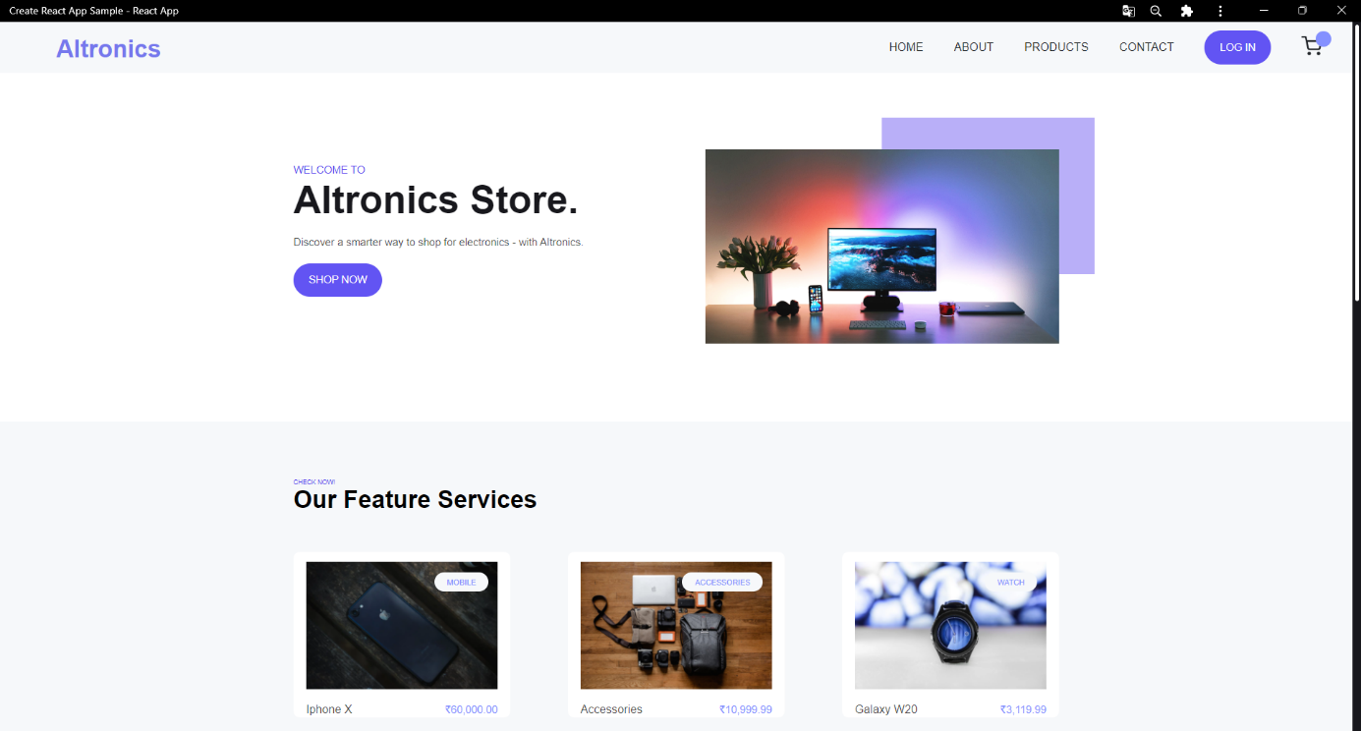
User Interface and Design Aspects
UI of Home Page Layout

Slide 16
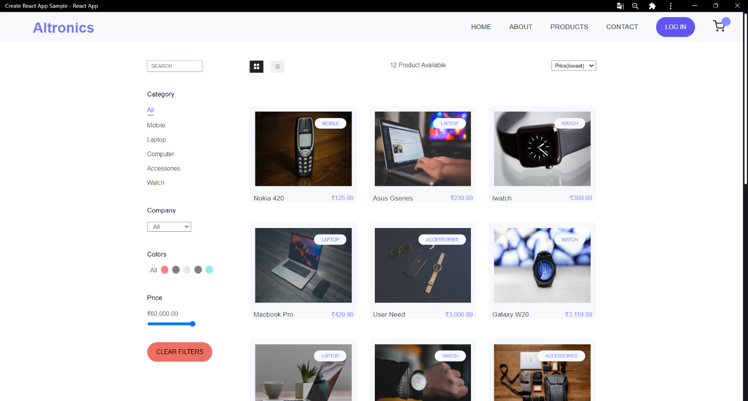
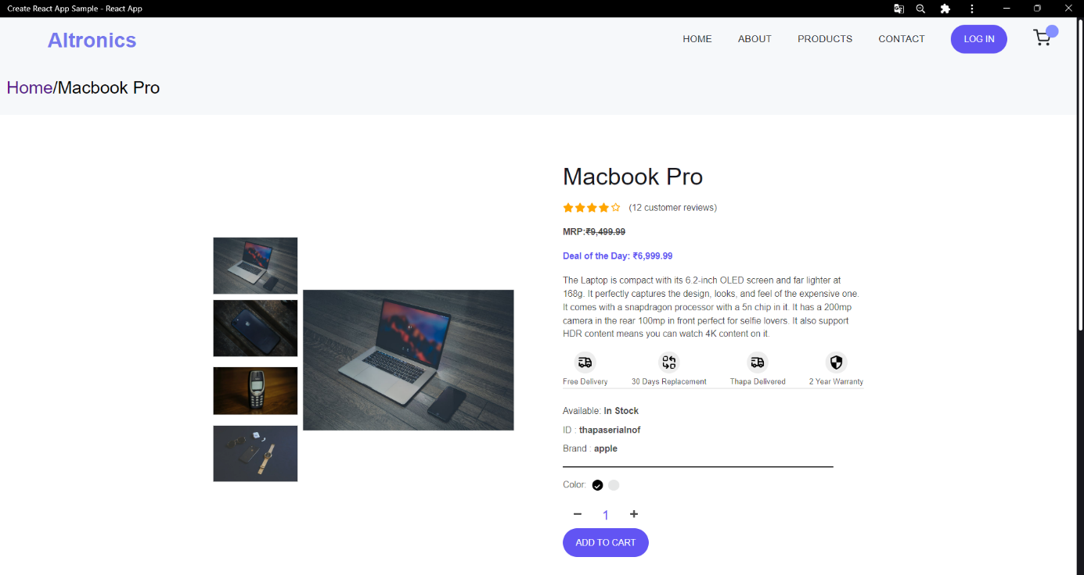
UI of Product Page Layout
UI of Product Order Page Layout

Slide 17
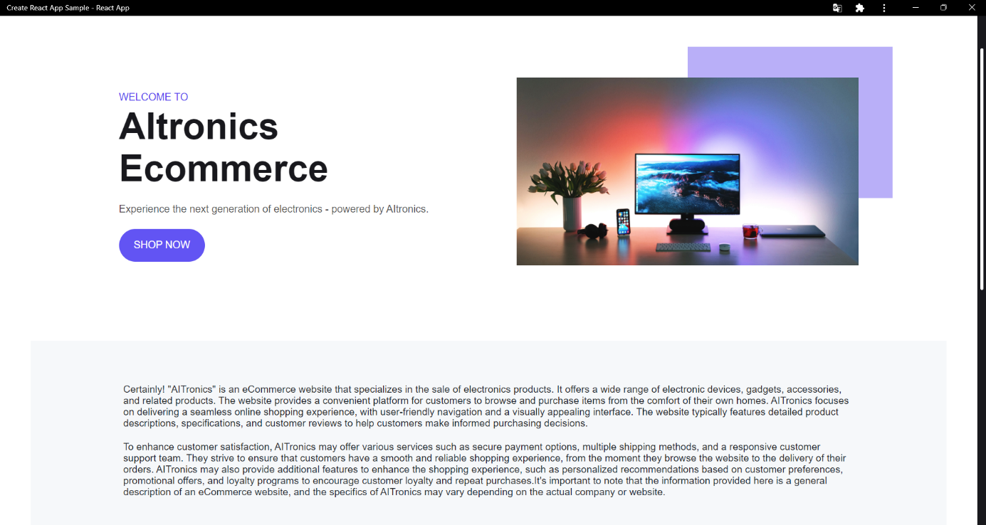
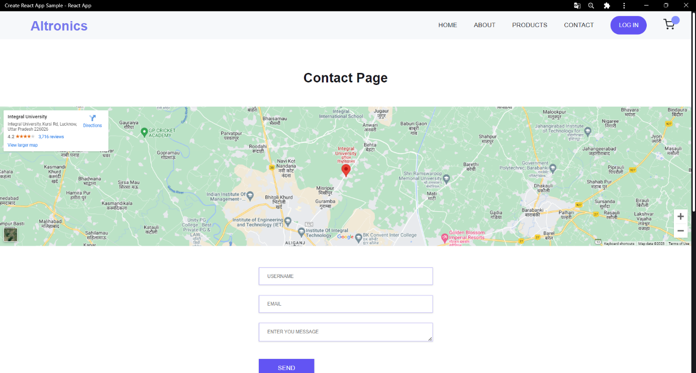
UI of About Page Layout
UI of Contact Page Layout

Slide 18
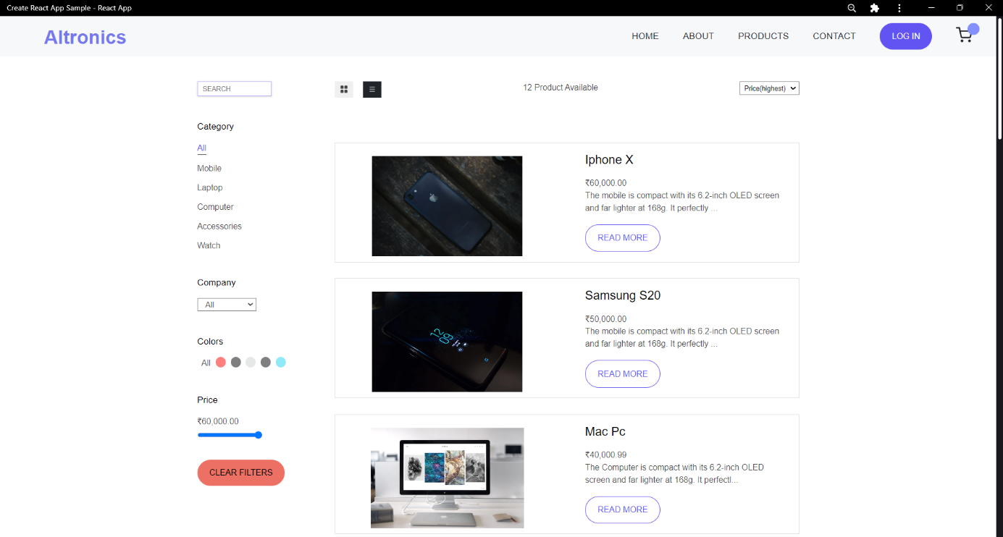
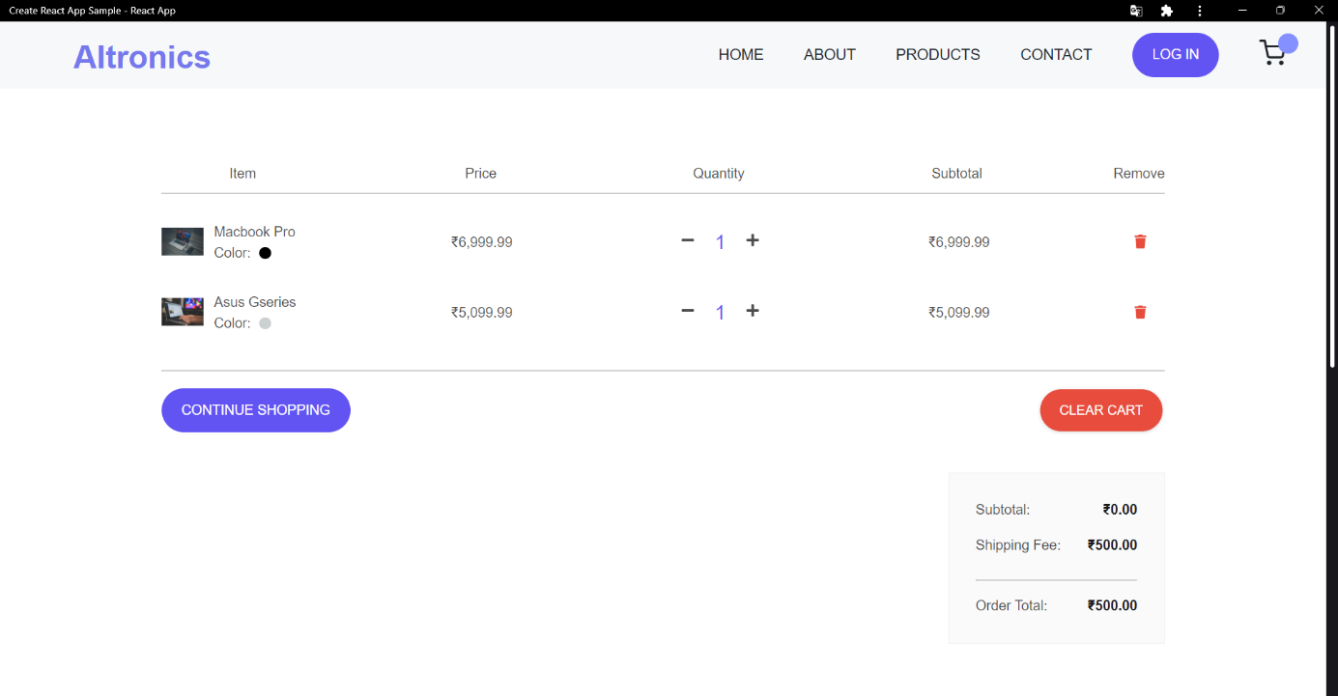
UI of Featured Product Page Layout
UI of Cart Page Layout

Slide 19
Conclusion
.
The goal of this project was to study different characteristic of each technology in the MERN stack and develop a full-stack e-commerce web application based on it. The application was successfully developed at the end. In conclusion, the MERN Stack offers a comprehensive and efficient solution for developing e-commerce applications. By leveraging MongoDB, Express.js, React.js, and Node.js, developers can harness the power of a unified JavaScript ecosystem. The MERN Stack's benefits lie in its simplicity, flexibility, and scalability. It enables developers to work with a single language throughout the entire stack, streamlining development and fostering code reusability. Real-time updates, experiment with additional tools, actively engage with the community to expand your expertise and robust scalability features make the MERN Stack an ideal choice for building high-performance e-commerce applications. Embrace the opportunities offered by the MERN Stack and unlock the potential to create innovative and successful e-commerce solutions. MERN stack is an excellent choice for major projects. Moreover, the MERN stack offers flexibility in integrating with third-party services and APIs, facilitating seamless integration of payment gateways, shipping providers, and analytics tools, among others. It also allows for easy deployment and hosting on cloud platforms.

Slide 20
THANK YOU.
Any Queries?

